Slide 1
SMART Home
Group 2:
John Satterla – Computer Engineer – Wireless Connectivity
Zachary Eakerns – Electrical Engineer – Biomedical Station
Zarka McClung – Computer Engineer – Facial Recognition
Christian Jensen – Electrical Engineer – Voice Recognition

Slide 2

Last Week's Deliverables
John Satterla
Zachary Eakerns
Zarka McClung
Christian Jensen
Finalize values for lowpass filters and types of amplifiers
Find out how to extract Sp02 value from our readings
Finalize which appliances to use (Monitor and Servo)
Select connectivity options (Bluetooth Vs WiFi)
Start researching algorithm and concept behind code (Research phase)
Finalize wireless communication protocols and begin hardware selection
See if on hand wireless devices are suitable for BLE beacon application
Design and order parts for relay circuit
Research Raspberry Pi Smart home front ends

Slide 3
Changes From Original Plan
Medical devices, specifically a pulse oximeter, can be high inaccurate due to even small amounts of movement
To get more meaningful, useful data the device will no longer be connected to the person
Instead, a station will be placed in the home that the patient can sit down with and check vitals
This approach emphasizes accuracy over mobility

Slide 4
Troubles With Filters
Although the values needed to make the amplifiers and filters are simple to calculate, real life results vary heavily from theoretical ones
For the EKG machine the lowpass filter is cutting down on the voltage much quicker than anticipated
While this should still work, fine tuning needs to be done to be able to create a more accurate machine

Slide 5
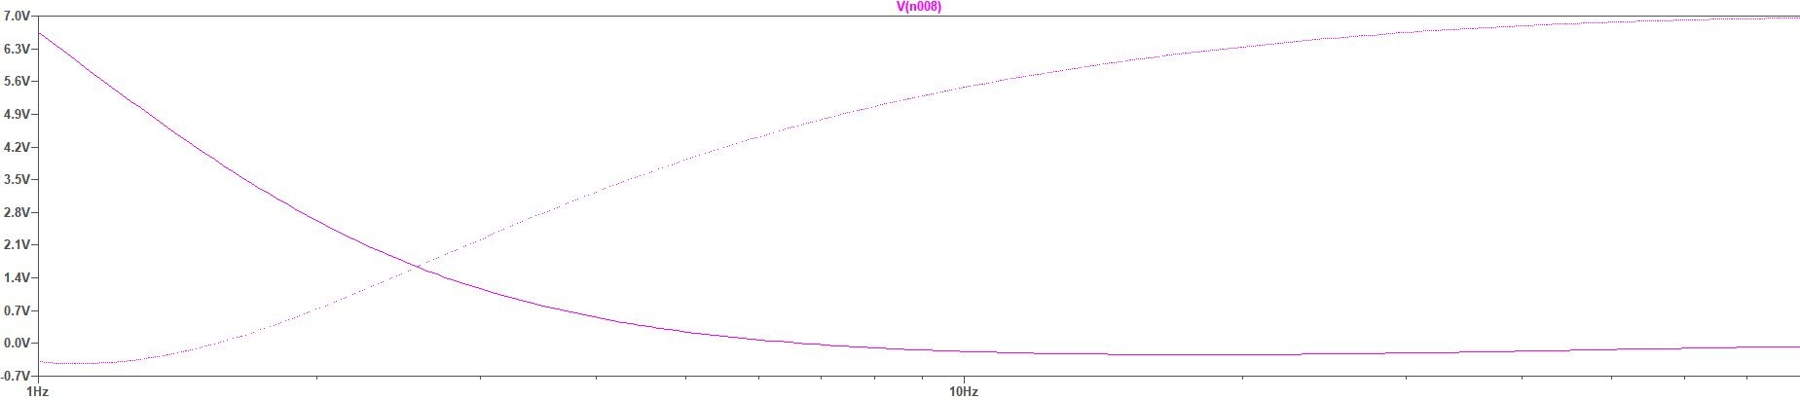
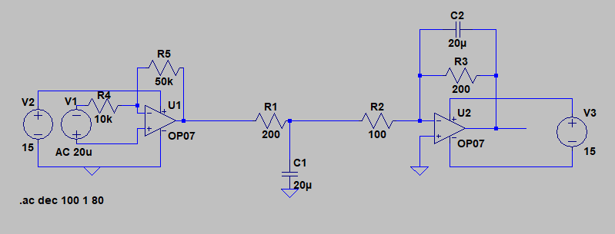

Slide 6

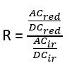
Pulse Oximetry Calculations
There are two main ways of calculating the oxygenation of blood through pulse oximetry
The first is using the equation
Where

Slide 7
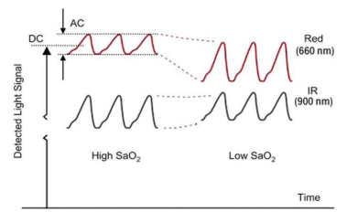
[4]

Slide 8

Pulse Oximetry Calculations Continued
Another method uses only the AC values of the signal, which are obtained by a peak detector
The formula for this method is the same as previously, however to find R the following equation is used instead

Slide 9
Hardware for Biomedical Station
The processing power needed to calculate EKG and Pulse Oximetry signals is not great, so a low powered microcontroller should help cut back on unnecessary power loss
For this reason, the TI MSP430FG439 [5] will be used for calculations, while a laptop will display the generated data

Slide 10
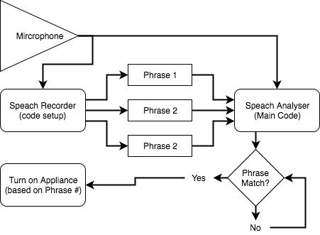
Voice Recognition - Rough Code outline

Slide 11
Voice Recognition Methods
Matlab [6]
Would use the computer and its microphone to detect voice
Less compact
More powerful (full-size PC)
Voice Detection plug-in for the SimpleLink™ MCU Software Development Kit (SDK) [7]
Using a MSP432P401R
High precision ADC
More compact
More complicated
Process:
Save phrases for specific words
Set specific actions for each phrase
Analyze incoming speech (look for saved phrases)
Complete action when phrase is called
*The system will be speaker dependent
(Only recognizing one specific person's commands)

Slide 12
Controlling Devices Wirelessly with Zigbee
Zigbee is a Wireless, low power mesh networking protocol designed for home and building automation
It supports low data rates (250kbps) and works on top of the defined IEEE 802.15.4 physical layer
The protocol was standardized in 2003 and is maintained by the Zigbee Alliance
Zigbee is probably in most of your homes today, with smart hubs like the Amazon Alexa or Google’s Nest able to connect all devices together
John Satterla

Slide 13
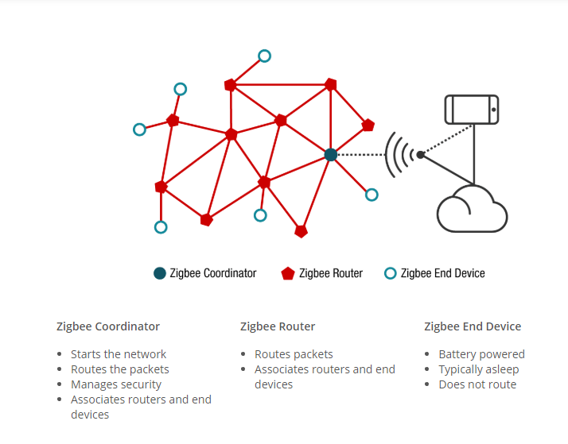
Controlling Devices Wirelessly with Zigbee
Zigbee Network Topology [8]
John Satterla

Slide 14
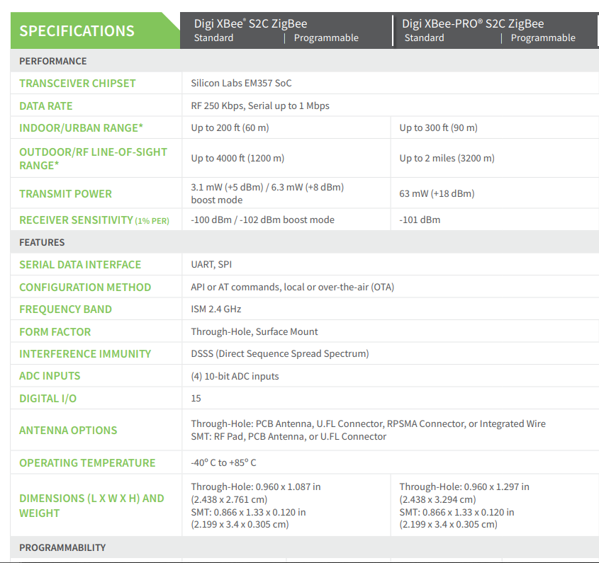
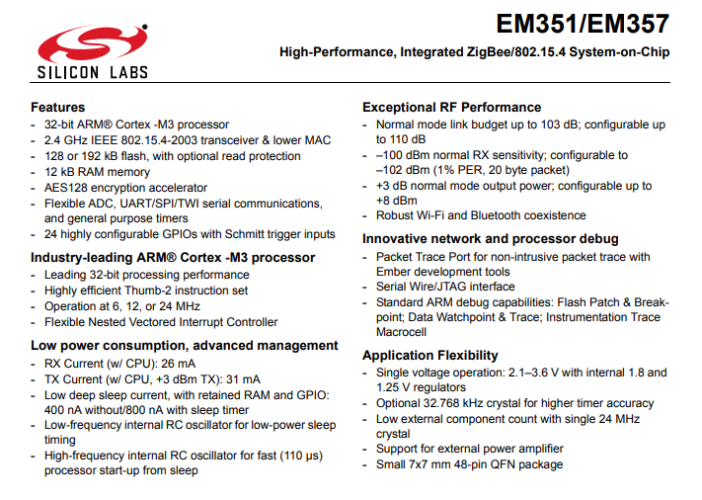
Controlling Devices Wirelessly with Zigbee
For our purposes, we will use Wireless microcontrollers that are integrated into Digi’s “Xbee” modules
[4]
[3]
John Satterla

Slide 15
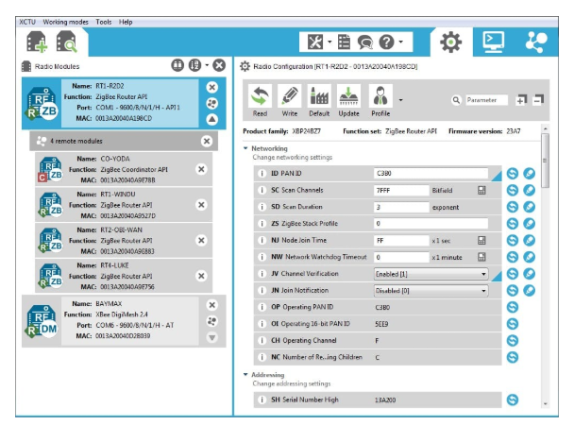
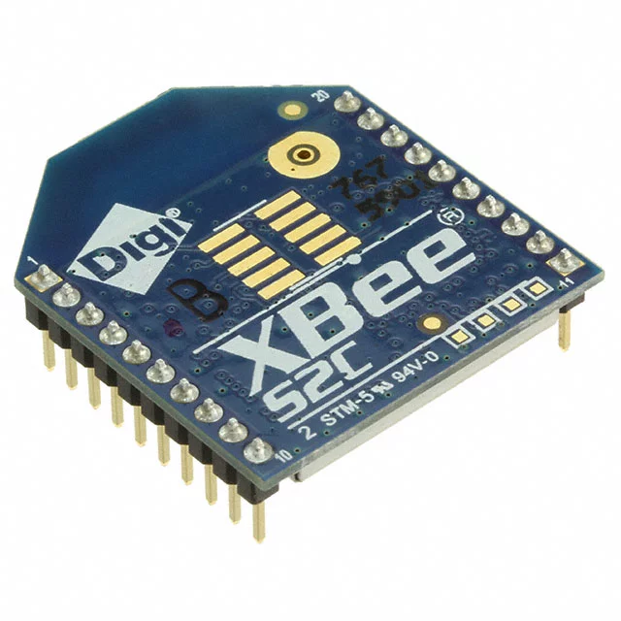
Controlling Devices Wirelessly with Zigbee
Using these so that we do not have to do any RF layout with wireless MCUs/ time constraints
Can communicate and be programmed separately for wireless purposes to form network with IDE, and then communicate back to main MCU via SPI or UART
[4]
John Satterla

Slide 16
OpenCV: Face Detection using Haar Cascades
WHAT IS HAAR CASCADES? ? ? ?
Haar Feature-based Cascade Classifiers
It is a machine learning based approach where a cascade function is trained from a lot of positive and negative images. It is then used to detect objects in other images.

Slide 17
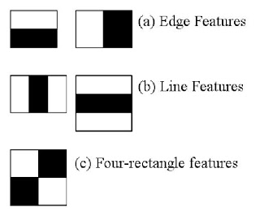
Concept behind the Algorithm
Initially, the algorithm needs a lot of positive images (images of faces) and negative images (images without faces) to train the classifier. Then we need to extract features from it.
For this, Haar features shown in the image are used. They are just like our convolutional kernel.
Each feature is a single value obtained by subtracting sum of pixels under the white rectangle from sum of pixels under the black rectangle.

Slide 18
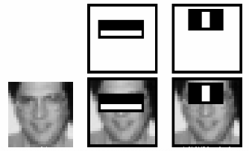
Calculation Method
For each feature calculation, we need to find the sum of the pixels under white and black rectangles.
To solve this, they introduced the integral image. However large your image, it reduces the calculations for a given pixel to an operation involving just four pixels.
It makes things super-fast.
But among all these features we calculated, most of them are irrelevant.
For example, consider the image above. The top row shows two good features. The first feature selected seems to focus on the property that the region of the eyes is often darker than the region of the nose and cheeks.
The second feature selected relies on the property that the eyes are darker than the bridge of the nose. But the same windows applied to cheeks or any other place is irrelevant. So how do we select the best features out of 160000+ features?

Slide 19
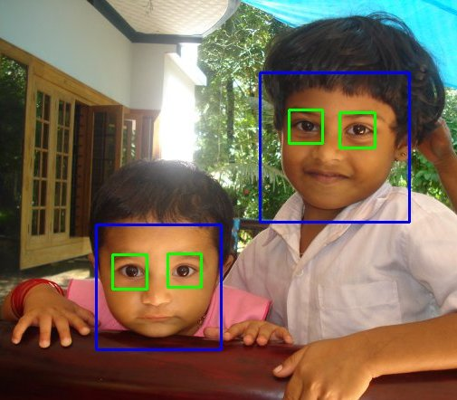
How do we select the best features out of 160000+ features?
For this, we apply each and every feature on all the training images. For each feature, it finds the best threshold which will classify the faces to positive and negative. Obviously, there will be errors or misclassifications. We select the features with minimum error rate, which means they are the features that most accurately classify the face and non-face images.

Slide 20
Microsoft Face API Research Phase
Microsoft trying to charge for Azure which you need in order to access Face API key (Will check if TTU license allows free Azure)
Similar concept (like OpenCV)
Still a consideration if it is FREE!

Slide 21
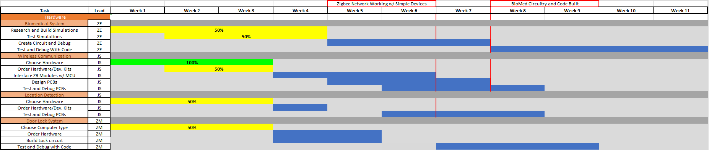
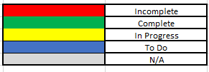

Gantt Chart

Slide 22
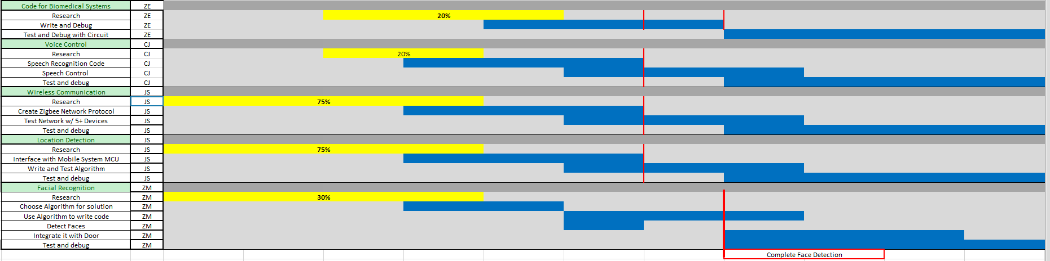
Gantt Chart

Slide 23
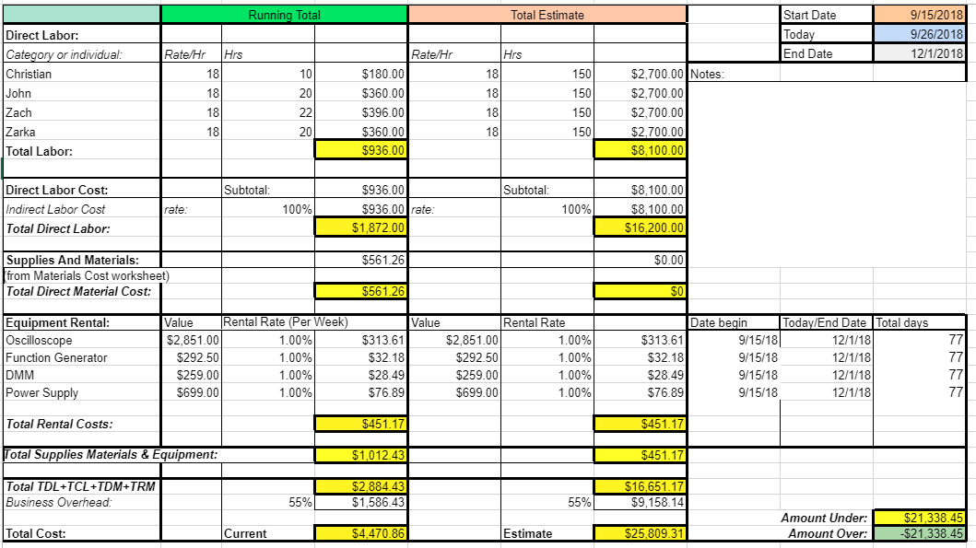
Budget

Slide 24
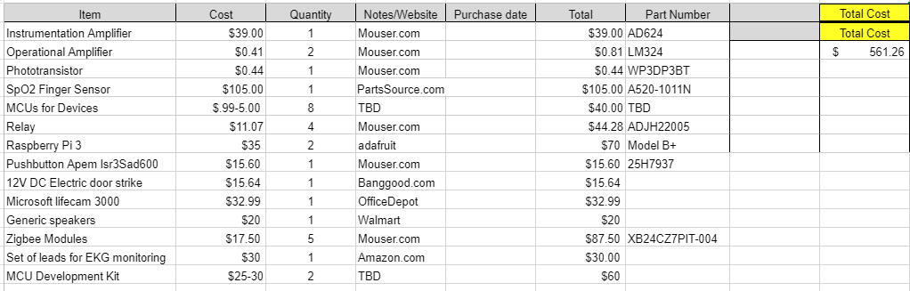
Material Cost

Slide 25
Next Week's Deliverables
John Satterla
Zachary Eakerns
Zarka McClung
Christian Jensen
Order and test Zigbee modules
Finalize and start developing with MCU development kits
Find software to more accurately simulate filters
Improve filter performance and prepare to construct actual circuits
Research Algorithm and try to implement it
Choose suitable programming language
Try to use webcam to test Algorithm with detection code
Work with Matlab to achieve voice recognition

Slide 26
References
“DIGI XBEE® AND DIGI XBEE-PRO® ZIGBEE,” digi.com, 2018. [Online]. Available: https://www.digi.com/pdf/ds_xbee_zigbee.pdf. [Accessed: 25-Sep-2018].
Docs.opencv.org. (2018). OpenCV: Face Detection using Haar Cascades. [online] Available at: https://docs.opencv.org/3.4/d7/d8b/tutorial_py_face_detection.html [Accessed 26 Sep. 2018].
“EM351/EM357 High-Performance, Integrated ZigBee/802.15.4 System-on-Chip,” silabs.com, 2013. [Online]. Available: https://www.silabs.com/documents/public/data-sheets/EM35x.pdf. [Accessed: 25-Sep-2018].
How to Design Peripheral Oxygen Saturation (SpO2) and Optical Heart Rate Monitoring (OHRM) Systems Using the AFE4403, 3AD. [Online]. Available: http://www.ti.com/lit/an/slaa655/slaa655.pdf. [Accessed: 20-Sep-2018].
“MSP430FG43x Mixed-Signal Microcontrollers,” Nov-2014. [Online]. Available: http://www.ti.com/lit/ds/symlink/msp430fg439.pdf. [Accessed: 23-Sep-2018].
Ning, D. (2018). Developing an Isolated Word Recognition System in MATLAB. [online] Mathworks.com. Available at: https://www.mathworks.com/company/newsletters/articles/developing-an-isolated-word-recognition-system-in-matlab.html [Accessed 24 Sep. 2018].
Ti.com. (2018). SIMPLELINK-SDK-VOICE-DETECTION-PLUGIN Voice Detection plug-in for the SimpleLink™ MCU Software Development Kit (SDK) | TI.com. [online] Available at: http://www.ti.com/tool/SIMPLELINK-SDK-VOICE-DETECTION-PLUGIN [Accessed 25 Sep. 2018].
“Zigbee | Overview | Wireless Connectivity,” SimpleLinkTM Zigbee Wireless MCUs, 2018. [Online]. Available: http://www.ti.com/wireless-connectivity/simplelink-solutions/zigbee/overview.html. [Accessed: 26-Sep-2018].

Slide 27
Questions?

